Slide 1


BacBon LMS (Learning Management System)
BacBon LMS offers a web-based learning management system without worrying too about cloud infrastructure. The LMS is easy to set up and can be accessible anytime, anywhere, injecting interactivity and flexibility to programs. LMS would be able to optimize time and resources and keep data safe. Besides, BacBon LMS upgrade learners’ knowledge and help them grow to the next level with personalized daily learning. It keeps tracking the eLearning process through online and robust reports. Recognize successful completion of training or course by the way of awarding certificates.

Slide 2



ABOUT
BacBon
BacBon Limited is a Social Enterprise established in 2013. We aim to feat the modern ICT innovation for the enhancement of the quality education of Bangladesh and reduce the gap between rural and urban area by ensuring access to quality education for all.
Focused with:
Education Platform Development, LMS, Contents Developments, Training ERP, Smart Solution for conference & training.
BacBon is the biggest Education Service provider in Japan Market. BacBon has been providing Quality English Lecture Correction (SLC) service to Japanese High School Students. Currently, more than 230 tutors are serving to above 70,000 Japanese students from 250+ high schools.
MEMBER OF

Slide 3

























Relevant
Experience
On LMS and
E-Content
Development
OUR CLIENTS
We are very pleased to deploy BacBon LMS (Learning management system) for BANK ASIA LTD., FIRST SECURITY ISLAMI BANK LTD., COMMUNITY BANK LTD. & POLICE STAFF COLLEGE recently for their regular usage. The system is prone to have more customization and continuous development for serving better features for both admins and end-users. We are happily serving all of our valuable clients.

Slide 4
Clients who are using our LMS currently
BacBon LMS
We are very pleased to deploy BacBon LMS (Learning management system) for BANK ASIA LTD., FIRST SECURITY ISLAMI BANK LTD., COMMUNITY BANK LTD. & POLICE STAFF COLLEGE recently for their regular usage. The system is prone to have more customization and continuous development for serving better features for both admins and end-users. We are happily serving all of our valuable clients.

Slide 5
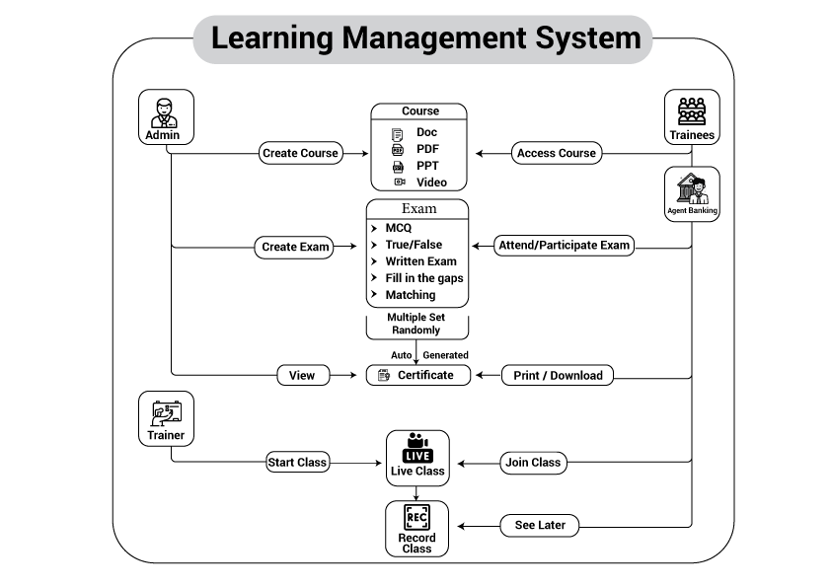
How does the LMS Work ?

Slide 6

Learning Management System
Easy Online Registration
Online Exams / evaluation
Easy Course Content creation
Video contents upload
Certificate exams / test set up
Quick test / Model test for trainee
Trainer management
Learner management
Training records Learners
Learner evaluation program settings
Automatic certification
Live trainings facility
Analysis and reports
Key
Features

Slide 7




Basic Modules
Course Management
Course creation
Video contents upload facility
Authorization for courses
Course Enrolment
Course enrolment facility
Department wise course enrolment
Access online courses
Test / Quiz Management
Mock tests and quizzes from admin panel
Randomization, question from different “Set”
True-False, Multiple-Choice, Matching type questions
Short Questions, Long Questions
Question Bank
Question Bank
Bulk upload
Random question access
Automatic quiz generation from Question Bank

Slide 8



Basic Modules
Evaluation Program
(Certificate)
Performance Records
Automatic certificates
Live Training Management
Live training schedule creation
Live class join
Anytime live class
CMS (Admin Panel)
Admin panel for CMS
Home page customization
Check and access all resources
Analytics & Reports
Interactive Dashboard
Reports
Statistics

Slide 9
Basic Modules
Agent Banking Course Access
Registration / Login
Course access, exam
Scripts (Readable Docs)
Video contents access
Quick Test
Certification Test
Result Summary
Automatic certificates

Slide 10
Features : Admin Panel
# ORGANIZATION PROFILE
Admin can set company profile (profile details later used in learner panel).
Admin can upload a logo for company which will later be displayed in learner panel.
Signature can be uploaded which can later be used on certificates.
# EMPLOYEE MANAGEMENT
Can create employee (one by one registration or bulk registration both possible)
Can set Department (later, department wise employees can be activated & deactivated, permission can be set etc.)
Can set employees role (employee role based permission can be set)
# ADMIN PANEL USER MANAGEMENT
Can create admin user (who will control admin panel)
# CERTIFIED EMPLOYEE HISTORY
Admin can check employees’ certificate achievements and print certificate.
# COURSE CREATION
A course includes one or more subjects underneath it. Each course may contain Certification Test & Quick Test.
# SUBJECT CREATION
A subject includes one or more scripts, video-contents.it. Each subject may contain Certification Test & Quick Test too.
Learning Management System

Slide 11
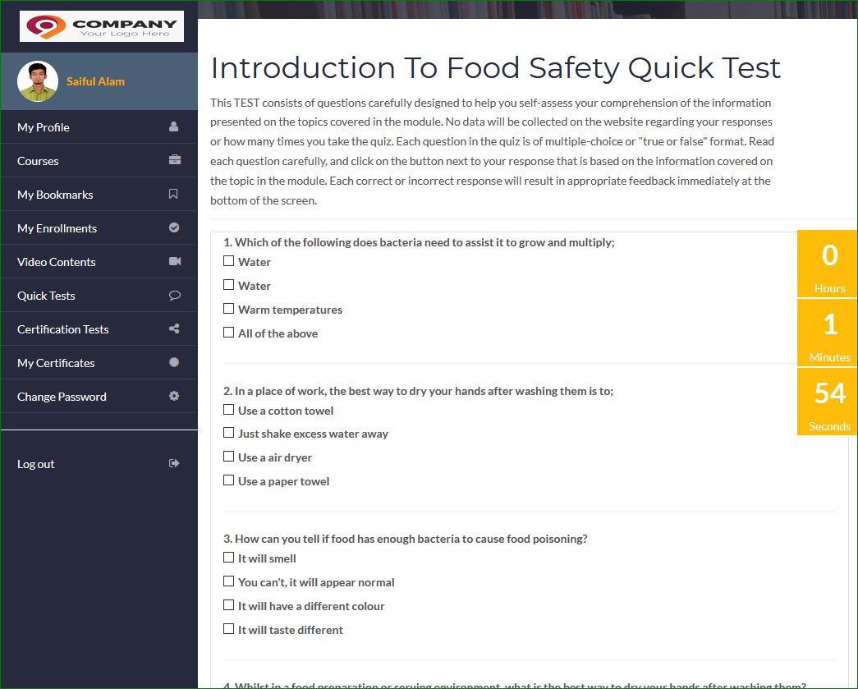
Features : Admin Panel
# QUICK TEST CREATION
Usually, quick-test contains 5-10 questions.
Admin can prepare series of questions for a question bank.
Questions from different sets are served from these question-banks.
Questions can be uploaded via excel file for a bulk uploads.
Admin can set how many times learner can attempt a quick-test through quota process. - Admin can set how many questions should be shown to learner for a quick-test. For an example, question-banks may contain 100 questions, but only 10 randomized questions can be set for a quick-test.
Learning Management System

Slide 12
Features : Admin Panel
# CERTIFICATION TEST CREATION
Normally, Certification-test contains 30-50 questions.
Admin can prepare series of questions for a question bank.
Questions can be uploaded via excel file for a bulk uploads.
Admin can set how many times learner can attempt a certification
test through quota process.
Admin can set how many questions should be shown to learner for a quick-test. For an example, question-banks may contain 1500 questions, but only 50 randomized questions can be set for a certification-test.
# COURSE ENROLMENT
Learner can enroll for any course that may contain different subjects underneath it.
Each subject may have one or more scripts for reading/downloading
Has video-contents for watching
Has quick tests and certification tests.
# SCRIPTS (READABLE DOCS)
Learner can read/download scripts in the form of docx, ppt etc.
# VIDEO CONTENTS
Learner can watch multiple video-contents in the browsers.
# QUICK TEST
- Learner can take part in quick-tests, which often has 5-10 questions to answer under 2-5 minutes. - Each question in the quiz is of multiple-choice format.
Learning Management System

Slide 13
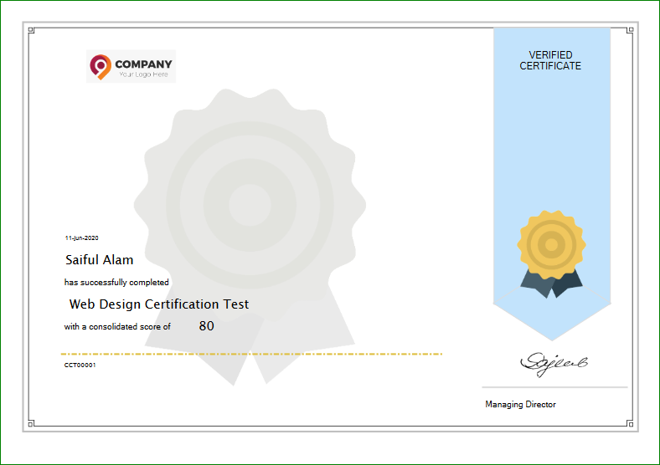
Features : Learner Panel
# UPLOAD SCRIPTS
Admin can upload scripts (i.e. docx, ppt) for learners to download and study.
# UPLOAD VIDEO-MATERIALS
Admin can upload video-materials for learners to watch it online.
# CERTIFICATION TEST
After giving an exam, the certificate will generate automatically for the user.
Learning Management System

Slide 14
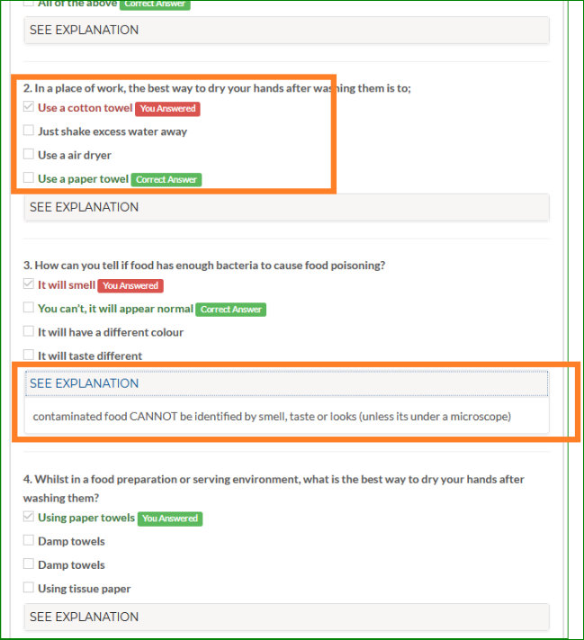
Features : Learner Panel
# RESULT SUMMARY
Regardless any quick-test or certificate exam, learner will be shown test-results with correct and wrongs answers.
It shows summary of his/her success rate.
Learner can be directed to particular segment of a video (e.g. 10 min 7 sec) to explain where the answers are discussed if tests are taken under a video-content.
It is also able to provide explanation about correct answers.
Learning Management System

Slide 15
Special Feature for AGENT Banking
# LOGIN AND COURSE ACCESS
Banking Agents can enroll for any course after login.
# SCRIPTS (READABLE DOCS)
Agent/ARO/ASO can read/download scripts in the form of docx, ppt etc.
# VIDEO CONTENTS
Agent/ARO/ASO can watch multiple video-contents in the browsers.
# QUICK TEST
Agent/ARO/ASO can take part in quick-tests, which often has 5-10 questions to answer under 2-5 minutes.
Each question in the quiz is of multiple-choice format.
# CERTIFICATION TEST
A learner can take part in Certification Tests. After giving an exam, the certificate will generate automatically for the agent-user.
# RESULT SUMMARY
Regardless any quick-test or certificate exam, learner will be shown test-results with correct and wrongs answers.
It shows summary of his/her success rate.
Learner can be directed to particular segment of a video (e.g. 10 min 7 sec) to explain where the answers are discussed if tests are taken under a video-content.
It is also able to provide explanation about correct answers.
Learning Management System

Slide 16
Live Training : Trainer - Trainee
# LIVE TRAINING
Trainer can log into a website and start taking live training (zoom live training will be integrated)
Trainee can join classes/trainings
Zoom regular features are available
Both party need browsers to start and join class/trainings.
Learning Management System
# OTHER FEATURES
Learner study hours/statistics
Learner video-watching hours/statistics
Learner document access/view count
Specific learner reports

Slide 17



Technologies
Team with Highly skilled senior developers and professional IT engineers
Programming Languages:
C#
ASP.net
MS SQL Server
JavaScript,
JQuery,
Axios
Angular

Slide 18


Tech Specifications
Hardware Requirement:
VPS windows server
Minimum 4 vCores
CPU 16-32 GB RAM
500+ GB Hard Drive initially, SSD preferable
(later need to extend depending on data increment)
Software Requirement:
IIS server
Windows Server 2016 +
with .NET Framework 4.7.2
MS SQL Server 2012 or above
Other Requirement:
Domain minimum 1 and subdomain as necessary.
SSL Certificates
NOTE : The above configuration (i.e. Server, Domain, Database, SSL certificate) may incur charges monthly.

Slide 19
OUR CONTACT
MAILING ADDRESS
House: 13 (5th Floor), Block: C, Banasree, Main Rd,
Dhaka 1219
PHONE NUMBER
+88 02 839 6601
E-MAIL ADDRESS
info@bacbonltd.com

